Slide 1
TRADEMARK EXPLOITATION ARE WE ?

Slide 2
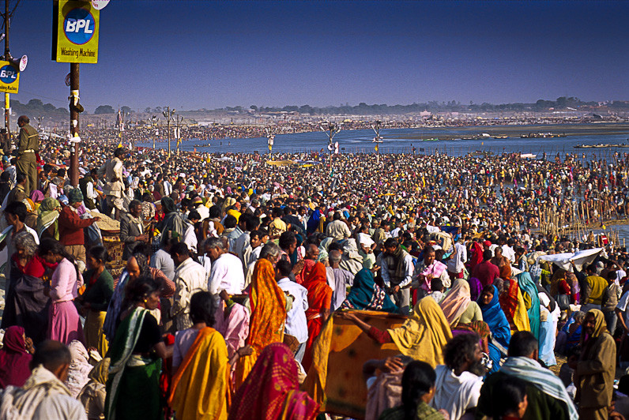
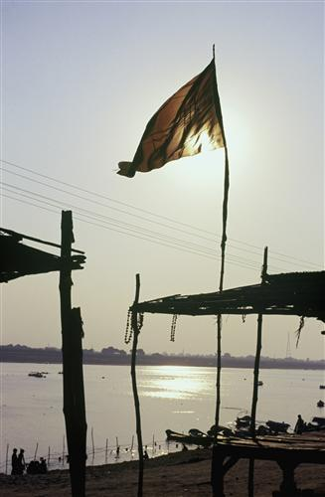
SANGAM ALLAHABD

Slide 3
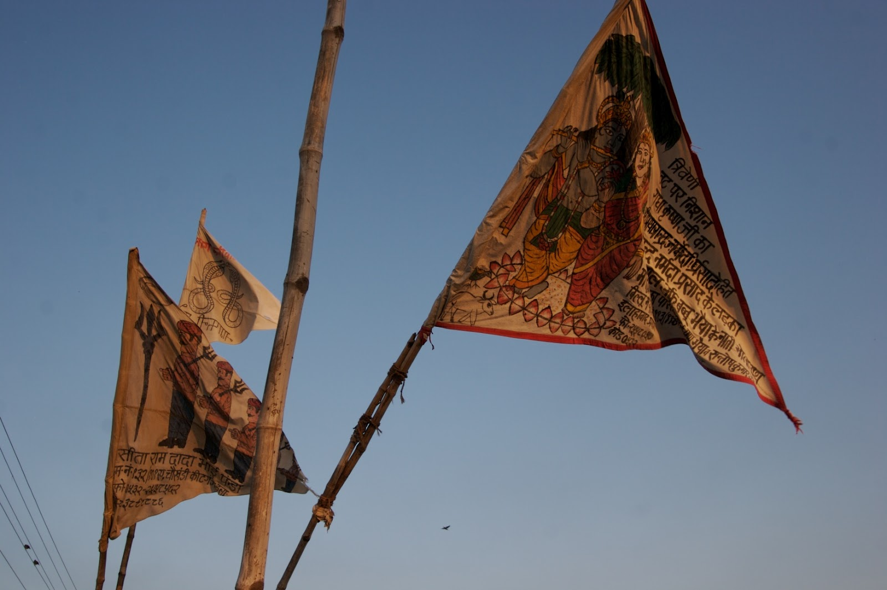

Slide 4
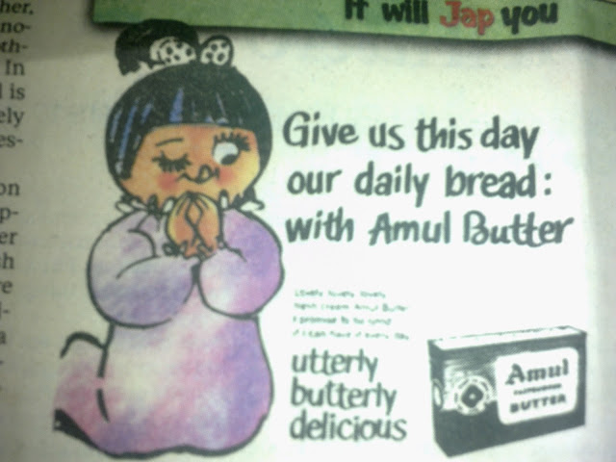
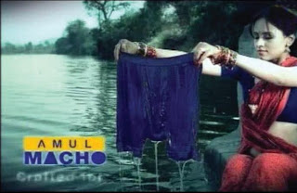
1950(Co-operative dairy giant Amul is now a 3 billion dollar brand. ) | 1980

Slide 5
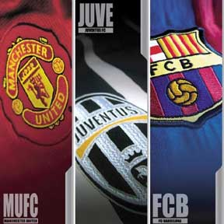
HONGKONG LICENSING SHOW-2013 16,000 visitors from 110 countries and regions
Product Specifications:With this licensing service you can produce products featuring the image of the most famous football clubs in the world. These include FC Barcelona, Manchester United and Juventus. Recent licensing includes apparel from Boshiwa and precious gold and metal ornaments.
Licensing scope: merchandise.
Territory: Greater China (China, Hong Kong, Macau, Taiwan).
PPW Sports & entertainment(Hong Kong) Limited - Hong Kong

Slide 6
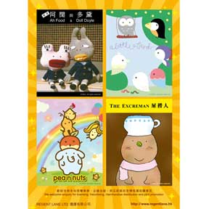
HONGKONG LICENSING SHOW-2013 continue..
Product Specifications:Featured here is a licensing service of a series of original cartoon characters. These characters come with simplistic shapes and distinct styles that attract consumers. Cooperation in form of franchising, merchandise, distribution and joint promotion is welcome.
Services of design, production, wholesales, retail and marketing promotion are available.
Regent Lane Limited - Hong Kong

Slide 7
Continue-HKTDC Disney Licensing:
Product Specifications:The presented Disney licensing is offered by Synthesis Design + Manufacture Ltd. The company offers customized development solutions from strategic product planning to shipping finished products. Disney is a worldwide-know brand that will surely catch both kids and adult’s attention.Precise design.
Available in assorted products.

Slide 8
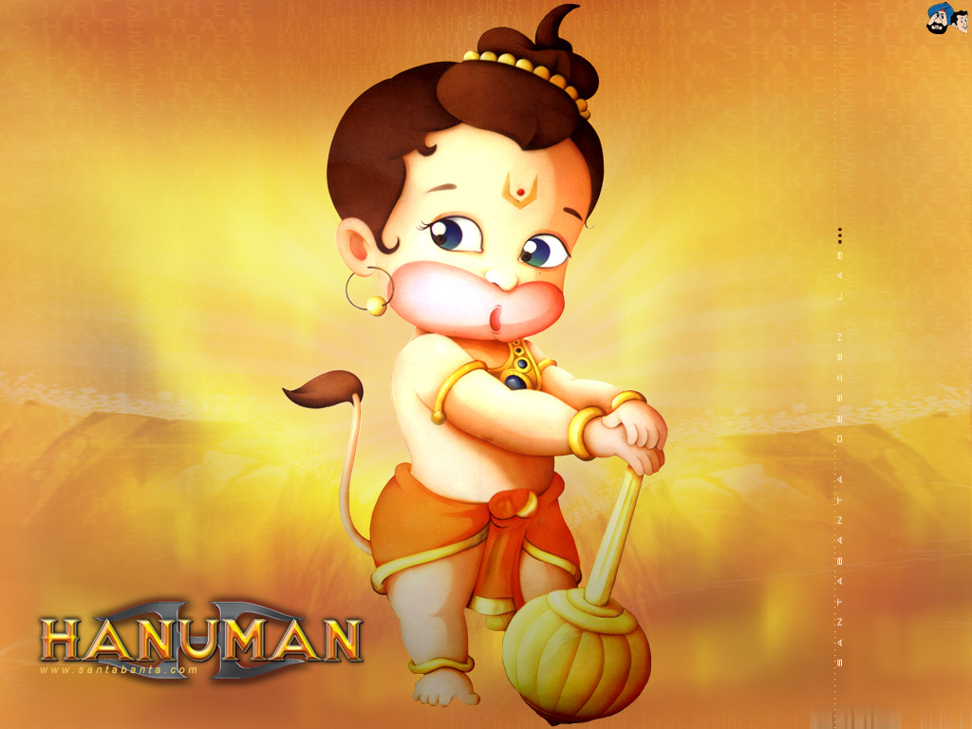
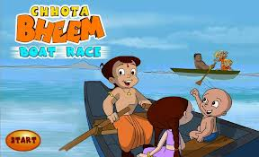
Indian Characters

Slide 9
CONCLUSION
SEARCH
WATCH
EXPLOIT

