Slide 1
IP-INITIAL®
Presented by
IP-INITIAL®
IP-INITIAL® is trademark/brand of Siddhast Intellectual Property Innovation , via which we provide training to IP- professionals , educational institutes in patent searching

Slide 2
IP-INITIAL®
Structuring Searches

Slide 3
IP-INITIAL®
Why to structure searches?
When most people go looking for information on the internet, typically they will type a few words into one of many common search engines and so the search engine gives them a list of results, which may or may not be relevant to their interest. But when the stakes of search are higher, if one risks missing an opportunity to receive a patent or losing his/her business in a patent infringement lawsuit, will he/she be satisfied with ‘good enough’? Probably not. That’s why a serious searcher will take a more systematic approach to structure their searches.

Slide 4
Quality vs. Quantity
IP-INITIAL®
As easy as it is to do a casual search, you probably also know that there’s a difference between quality and quantity in terms of search results. The difference between a casual search and a serious search is that a serious search will allow you to balance recall (how wide the search is) with precision (how specific the search is).

Slide 5
Ask yourself
IP-INITIAL®
Are some words required to be in your result?
Are any words to be excluded?
Should some words be next to one another?
Should some words be near to one another, and how near?

Slide 6
IP-INITIAL®
The difference
Database systems often offer similar functionality – operators, phrasing, nesting and fields etc. – but the options from which you can choose, the specific functions available to you and how they work in practice will differ from one database system to another.
More than keywords:
As there are pitfalls relying on keywords alone, patent database systems often offer you a broad array of choices so that you can strike a balance between recall and precision in your search.

Slide 7
Choices available
IP-INITIAL®
You can search using:
Whole words or names, or just parts of them
Phrases
Classifications and other ways of identifying technologies
Numbers or dates
Parentheses i.e. brackets (nesting) to help determine how terms are combined
Fields e.g. the full text, the front page, or perhaps just the title, the abstract, the patent numbers, or the dates

Slide 8
In short
IP-INITIAL®
You can structure your search queries using operators, phrasing and nesting; and you can direct your search to selected areas of the database system by specifying which fields are to be searched.

Slide 9
IP-INITIAL®
Boolean operators
These are the most commonly used operators in online searching and are derived from Boolean algebra, the basis of digital computer logic.
This Boolean algebra is developed by a philosopher and mathematician, George Boole, born in 1815.
These Boolean operators are nothing but the common words AND, OR, and NOT.

Slide 10
Is it really simple as it seems?
IP-INITIAL®
If someone asks, ‘ what you had for breakfast today?’
You might say “bread, butter and cheese.”
But if they ask, ‘What sort of things you generally have for your breakfast?’
Your answer will be somewhat different now.
You might say “cheese, eggs, fruit, toast, butter and juice.”

Slide 11
IP-INITIAL®
The first answer is logically sound – you did indeed have bread AND butter AND cheese. But the second answer is ambiguous – unless you are a very hungry person, you probably don’t have all of those items for breakfast at the same time.

Slide 12
IP-INITIAL®
Both the answers would be correctly interpreted by a human listener because the words would automatically be placed into context.
A computer, however, interprets things literally and so would conclude that you have all those items for breakfast at the same time.

Slide 13
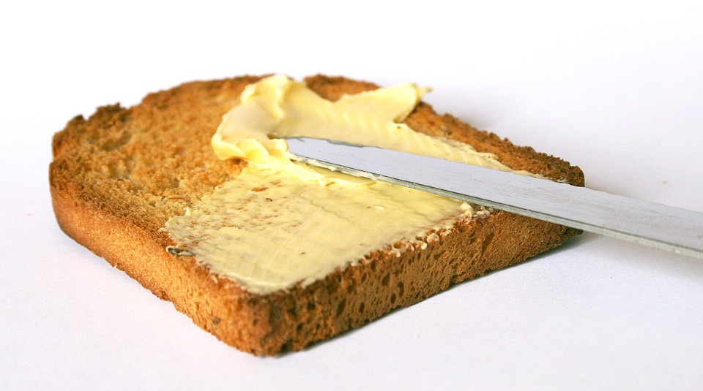
IP-INITIAL®
Some internet search engines do actually acknowledge possible ambiguities by searching for all possibilities, i.e. they search for each word individually – cheese OR eggs OR fruits OR bread etc. – and also for any combination of these words.

Slide 14
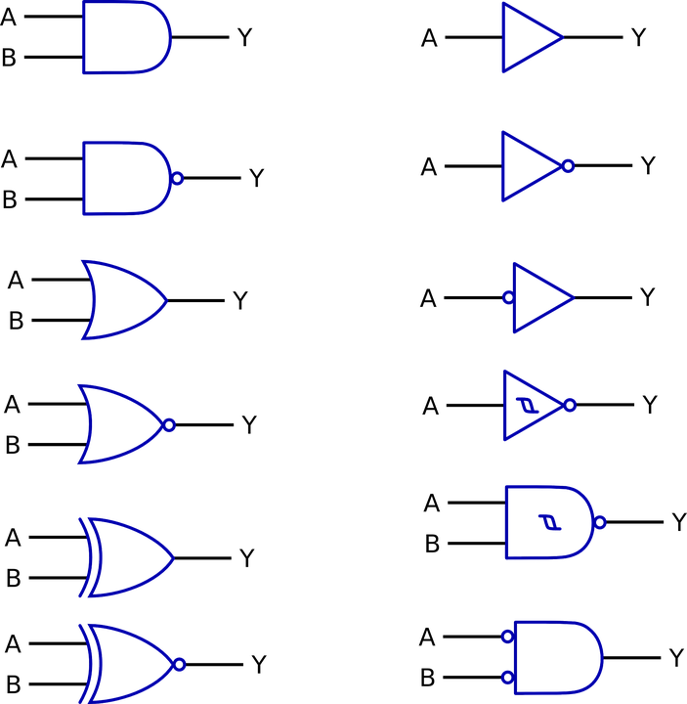
IP-INITIAL®
Thus, it becomes important to think carefully about exactly what it is you want to search for – and to express it accurately and unambiguously using the correct Boolean operators. The computer will then do exactly as it has asked to, nothing less and nothing more.

Slide 15
Basic operators
IP-INITIAL®
Refer the following table:
Result | Search terms
Documents containing the word tennis but not ball | Tennis NOT ball
Documents containing either the word tennis or ball but not both | Tennis XOR ball
Documents containing the word tennis and ball | Tennis AND ball
Documents containing either the word tennis or ball or both | Tennis or ball

Slide 16
IP-INITIAL®
Boolean operators are often represented by AND (or simply +), OR, and NOT (or simply -) and XOR (meaning either of the words but not both). From the table,
tennis AND ball : retrieves documents containing the words tennis and ball
tennis NOT ball : retrieves documents containing the words tennis but not ball
tennis Or ball : retrieves documents containing either the word tennis or ball or both
tennis XOR ball : retrieves documents containing either the word tennis or ball but not both

Slide 17
The default
IP-INITIAL®
In many patent database systems, such as PATENTSCOPE, if you use a group of words and don’t put in an operator – either by design or error – then the system will assume you mean to use AND.
So, inputting bread butter cheese will cause the system to search bread AND butter AND cheese. Only documents with all three words will be found.
Boolean operators can also be used to combine searches in different fields. This will be explained later.

Slide 18
Proximity operators
IP-INITIAL®
We know that searching using keywords can throw up false drops, i.e. hits that contain the required words but have nothing to do with what’s being searched for. Proximity operators offer another way of dealing with this problem.

Slide 19
The problem
IP-INITIAL®
How can you exclude documents in which words are unlikely to be related to one another?

Slide 20
The solution
IP-INITIAL®
One way to limit the number of false drops and increase the precision of a search is to specify that the words being searched for must be near to one another.
Words are more likely to be related if they’re in the same sentence, or at least close to one another. This is where proximity operators come in.

Slide 21
The details
IP-INITIAL®
Different patent database systems use different proximity operators. Some common operators use NEAR or simply N, W (for with), ADJ (for adjacent).
They often represent a default range of terms, for example, a range of five terms but may also allow you to specify this range, by adding a number like N5 or W/12 or near:15. Some systems also use notations like “tennis ball”~5 to indicate that the words tennis and ball must be within five words of each other.
In some cases, the operator will also determine the order in which the search terms are found.

Slide 22
For example,
IP-INITIAL®
Proximity operators could be used like this:
Toothbrush NEAR reservoir will search for documents that have both the words toothbrush and reservoir within five words of one another (if five words is the default range).
“Toothbrush reservoir”~10 will search for documents that have both the words toothbrush and reservoir within ten words of each other.

Slide 23
Add some variety
IP-INITIAL®
While searching in the area of electrical technology, John wants to include the words electric, electrical, electronics etc.
So, he gives some thought as to the most elegant solution.
One way of doing this is to use a Boolean operator OR, i.e., to search electric OR electrical OR electronics.

Slide 24
IP-INITIAL®
Electr*
Electrical
Electronics
However a much neater and more convenient way is to truncate or shorten these words to their primary root or stem, which in this example is ‘electr’, and then to add a wildcard operator in order to increase the coverage of the search by looking for words beginning with ‘electr’.

Slide 25
IP-INITIAL®
*
%
$
?
Different database systems use different symbols as wildcard operators – for instance *, %, $, or ? to represent a specified number of characters. Most systems have a wildcard operator that represents anywhere from zero to an infinite number of characters. Some systems also have wildcard operators to represent exactly one character or either one or zero characters.

Slide 26
IP-INITIAL®
FOCAL
FOCUS
Wildcard operators that represent a specified number of characters may be able to be repeated to give multiples of the number of characters represented by those operators, for example “foc”?? might retrieve ‘focal’ or ‘focus’ if the question mark is used to represent exactly one character.

Slide 27
Positioning wildcard operators
IP-INITIAL®
Let’s look at a system that uses the asterisk to represent anywhere from zero to an infinite number of characters.
Right Truncation:
If we search electr*, then the system will find documents containing any of the words: ‘electric’, ‘electrical’, ‘electronics’ etc. This technique is called right truncation.
Note that if we had chosen to search elect* instead of electr*, then any documents containing words such as ‘elect’, ‘election’, ‘electoral’ etc. would also have been included, which may not be as useful for John.

Slide 28
IP-INITIAL®
Left truncation:
Some database systems allow left truncation, where the right hand part of the keyword is specified and the wildcard operator is used to the left of that.
This technique could be used, for instance, to search for all documents that refer to some sort of *scope e.g. ‘microscope’, ‘telescope’, ‘endoscope’ etc.

Slide 29
IP-INITIAL®
Internal truncation:
Some database systems, such as PATENTSCOPE, also allow you to use internal truncation, where the beginning and end of the keyword are specified, and a wildcard is used in the middle.
Here the wildcard operator * stands for any number of letters in the middle of the word – from zero upwards. So searching for elec*ty will find electricity; searching for elec*al will find electrical, but also electoral.

Slide 30
IP-INITIAL®
SLART:
Some database systems allow simultaneous left and right truncation – or SLART – where the middle part of the word is specified and wildcard operators are used to the left and right of that.
For instance, by using the middle part agon, this technique could be used to search for all documents containing the words ‘pentagon’, ‘pentagonal’, ‘hexagon’, ‘hexagonal’, ‘octagon’, ‘octagonal’ etc.

Slide 31
Automatic truncation or stemming
IP-INITIAL®
Electricity
Electrical
Electr
Some database systems automatically truncate words and search all variants based on this stem. They may offer you the option of selecting or deselecting this function.
With a stemming function activated, a word like ‘electricity’ would be automatically truncated to a common word stem like ‘electr’, searching for words like: ‘electrical’, ‘electronic’, and naturally, ‘electricity’.

