Slide 1

IP-INITIAL®
IP-INITIAL® is trademark/brand of Siddhast Intellectual Property Innovation , via which we provide training to IP- professionals , educational institutes in patent searching
IP-INITIAL®
द्वारा प्रस्तुत
IP ​​INITIAL® Siddhast बौद्धिक संपदा अभिनव के ट्रेडमार्क / ब्रांड है, जो के माध्यम से हम आईपी पेशेवरों तथा शैक्षिक संस्थानों के लिए प्रशिक्षण प्रदान करते हैं

Slide 2
IP-INITIAL®
उद्देश्य
एक पेटेंट क्या है ?
इसका उद्देश्य क्या ?
अधिकार यह धारकों के लिए देता है ?

Slide 3
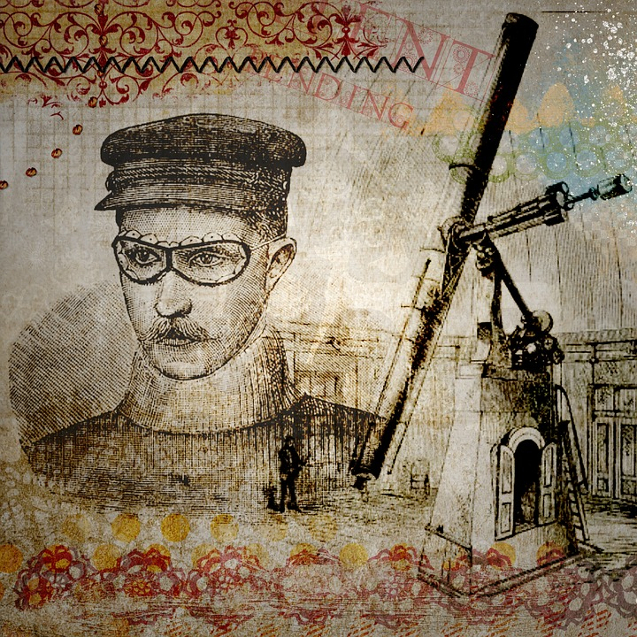
IP-INITIAL®
नवीन आविष्कारों के महान आविष्कार में महान विचारों को बदलने में पेटेंट ने महत्वपूर्ण भूमिका निभाई है .
Patents

Slide 4
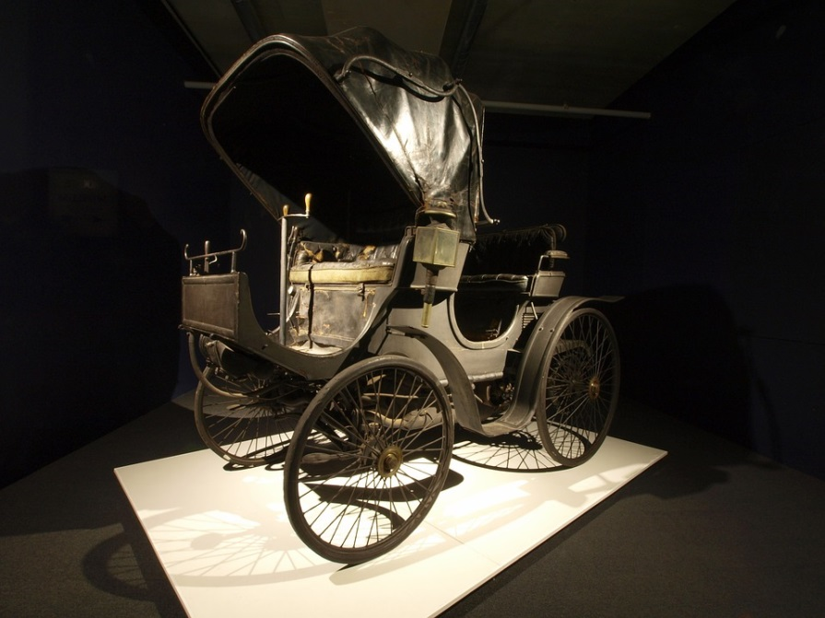
हमारी यात्रा से लेके…
IP-INITIAL®

Slide 5
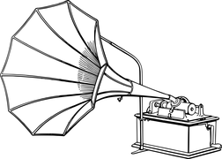

IP-INITIAL®
हमारे आराम तक ….

Slide 6
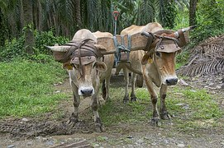
IP-INITIAL®
और सही भोजन के सेवन तक ..!!!

Slide 7

IP-INITIAL®
पेटेंट जिस तरह से हमारे जीवन जीने को आकार को मदद करते है...!!!

Slide 8
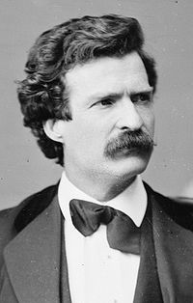
Mark Twain
IP-INITIAL®
American author and humorist
“A country without a patent office and good patent laws was just a crab but sideways or backwards”
एक पेटेंट कार्यालय और अच्छा पेटेंट कानून के बिना देश सिर्फ एक केकड़ा लेकिन बग़ल में या पीछे की ओर था

Slide 9



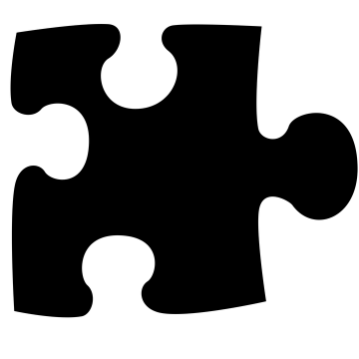
हम निम्नलिखित पेटेंट के बारे में पहलुओं को पता होना चाहिए :
पेटेंट किस लिए है?
कौन उन्हें इस्तेमाल करता है ?
वे कैसे और क्यों दी जाती है ?
क्या भूमिका वे हमारे जीवन में निभाते हैं?
IP-INITIAL®

Slide 10
IP-INITIAL®
पेटेंट किस लिए है?

Slide 11
पेटेंट किस लिए है?
IP-INITIAL®
तीसरी पार्टी से रोकथाम
Inventions
Patents
एक पेटेंट एक आविष्कार का शोषण करने से तीसरे पक्ष को रोकती है. पेटेंट का अधिकार व्यक्ति और कंपनी को होता है, उनके अनुमति के खिलाफ अविष्कार का इस्तेमाल करने को पेटेंट सिस्टम रोखति है

Slide 12

IP-INITIAL®
Benefits to public
Public
Inventions
Patents
दूसरों को भी पेटेंट का लाभ रहता है, जनता को पेटेंट कुछ मूल्य प्रदान करती है, विस्तृत जानकारी देती है जिससे कोई इन्वेंशन या अविष्कार कैसे काम करता है ये सबको पता चलता है.

Slide 13

IP-INITIAL®
Benefits to public
Inventions
Patents
पेटेंट धारकों के अधिकारों के लिए समय की अवधि निर्धारितकी गयी हैं और पेटेंट वैध रखने के लिए इस अवधि के दौरान बनाए रखा जाना चाहिए
समय की अवधि समाप्त हो गई है या अधिकार बनाए रखा नहीं किया गया तो किसी भी रूप से आविष्कार का दहन कर सकता है।

Slide 14
IP-INITIAL®
Striking A Balance..!!!

Slide 15



IP-INITIAL®
The patent system therefore strikes a balance between the interests of the individual or company that has invested in developing a new invention, and the interests of the public. In this way , the patent system encourages the rewards innovation – which is a primary driver of economic development.

Slide 16
IP-INITIAL®
Why it is important?

Slide 17
IP-INITIAL®
Government
Governments around the world aim to increase the wellbeing of their people by ensuring economic growth .
Innovations
In order to economics keep growing we need to people to invest in developing and bringing new technologies to market. That’s what innovation is – and vital part of creating growth.
Notes:
In order to economics keep growing we need to people to invest in developing and bringing new technologies to market. That’s what innovation is – and vital part of creating growth.

Slide 18
IP-INITIAL®
But imagine if you spent years coming up with a great invention, investing a great deal of money into it, only for a competitor to copy your idea and start making money from it straight away. It could make all that effort a waste. The only way to protect it would be to keep it a secret.
Keep it secret

Slide 19

IP-INITIAL®
Generate funds
That’s where the patent system comes in. It allows individual and companies to recover the costs of developing an invention and generate funds to develop new ideas while allowing others to learn from the invention and build on this knowledge. In this way, the patents system provides incentives for innovation and helps stimulate growth.

Slide 20
IP-INITIAL®
Deal..!!!
State
Inventor
The patent system is essentially a deal between the state and the inventor. The inventor must provide a full description of how the invention works. In return, the state grants the inventor a patent, an exclusive right to exploit the invention.

Slide 21
IP-INITIAL®
What is in it for inventor?
Inventors benefit by gaining the right to prevent others from making, using, distributing or selling their invention without their permission.

Slide 22
IP-INITIAL®
What is in it for us?
As well as benefiting the inventor, it also benefits a much wider group. Patents are published, putting full details of the inventions into public domain. This means everyone can have access to knowledge of the latest advances in technology which in turn can help guide further research and development.

Slide 23
IP-INITIAL®
Making
Selling
Importing
Owner
The owner of the patent is granted the exclusive right to prevent anyone making, using, selling or importing the invention without his or her consent.

Slide 24

IP-INITIAL®
But who do you think owns a patent once it has been granted?
?

Slide 25
IP-INITIAL®
The inventor?
The organization the inventor works for?
Anyone the inventor wants to sell the patents right to?
The owner of the patent is not necessary the inventor.
Depending upon employment contracts or applicable national law, it could belong to the inventor’s employer. Such as an industrial corporation or a university. And just like other types of property rights, patents can be sold to someone or licensed out if the owner wishes.

Slide 26

IP-INITIAL®
What are the limits?
Owing patents doesn’t mean you have unlimited rights over an invention, patents are restricted in both time and territory.
In many countries, the maximum period during which a patent may remain in force (the ‘patent’ term) is 20 years from the date of filling. This is in contrast to trademarks, which owners can renew as many times as they like, And often patents run for much shorter periods. This may be because the owner is no longer making out of the patent and chooses to let it lapse.

Slide 27
IP-INITIAL®
Patents are territorial
Patents are territorial, this means that, to get a patent in China, you need to apply to the patent office in China and the same goes for Brazil, Cuba, The United States and so on. The resulting patents will then only protect you in those countries.

Slide 28
IP-INITIAL®
In some areas of the world, you can make a single application to a regional patent office to get protection in a number of countries. For example, there are regional authorities for Europe and Eurasia, and two in Africa

Slide 29
IP-INITIAL®
Because patents are territorial, anyone outside the territories in which patent rights have been granted can take advantage of the idea even while a patent is in force. They can make , use, sell or import the invention without the owner’s consent. And once the patent has lapsed, anyone anywhere can do so.

Slide 30
IP-INITIAL®
So, one vital outcome of the patent system is to make a vast source of information on new technology available for anyone to use at no charge, across all technical fields. This has hugely beneficial effects.
For example, new farming technologies that have been invented in Europe and the United states could be exploited freely by individuals, companies and governments in developing countries.

Slide 31
IP-INITIAL®
Do you have to patent?
John and Reema are the owners of an industrial printing company that has developed a new liquid applying system that prevents printer rollers degrading through extended contact to application liquid. This is clearly a new technology. What should John and Reema do?
?
John
Reema

Slide 32

IP-INITIAL®
They are free not to patent their technology and keep it secret, but other companies would be free to make use of it if they can figure out how John and Reema’s technology works.

Slide 33

IP-INITIAL®
John and Reema are under no obligation to protect their invention with a patent, the process of obtaining a patent can be costly. They could simply choose to try and keep their technology secret. Or they may not mind if other companies copy their technology in some or all areas of the world.

Slide 34
IP-INITIAL®
Countries across the world grant patents, and inventors , universities , research centers, governments and companies – from one man businesses to multi national corporations – use the patent system to protect their technologies.

Slide 35
IP-INITIAL®
They play significant role in life and society by :
Protecting individual and company investment in invention
Disseminating new technical information
Encouraging innovators.
Driving innovation
Stimulating economical growth.

